Slide 1
The Quantum Many Body Problem
Casey Sobecks

Slide 2
Outline
Background
Model/Implementation
Benchmarking
Results
Discussion/Questions

Slide 3
Background
Quantum Many-Body Problem covers many fields and areas of research in physics.
General definition: “the problem of predicting the properties of systems of several quantum particles from the first principles of quantum mechanic” [1]
Examples: Superconductors, superfluidity, nuclear structures, molecular & atomic physics
For this project, will be following the work of Carleo, G. & Troyer, M. [2]
“Solving the Quantum Many-Body Problem with Artificial Neural Networks”

Slide 4
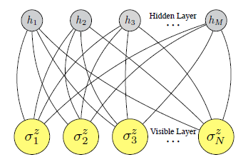
Model/Implementation
System: N discrete-valued degrees of freedom, spin ½
Structure: Restricted Boltzmann machine [2]
M=α*N

Slide 5



Model/Implementation
The variational expression the RBM is
Simplified:
with
Define the weights as W={a_{i}, b_{j}, W_{ij}} (should be complex values)

Slide 6


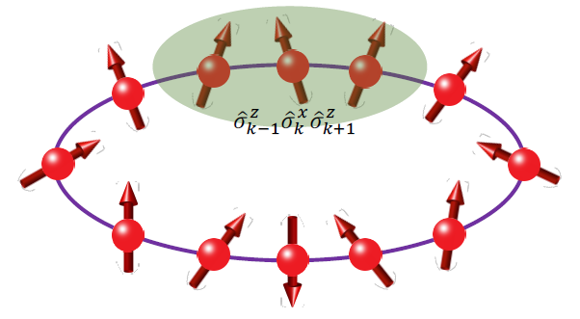
Model/Implementation
Transverse-field Ising Hamiltonian
Anti-ferromagnetic Heisenberg Hamiltonian
Source [4]

Slide 7

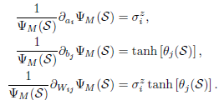
Model/Implementation
Stochastic Method
Want so, define
Need derivatives with respect to the weights.
With these, can update each weight (ex: a=a-νσ_{i}^{z})

Slide 8


Model/Implementation
Updating state using equation [2]
To minimize

Slide 9
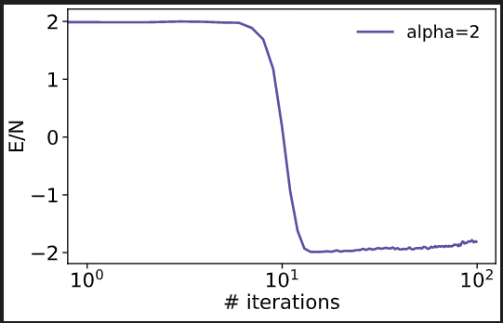
Model/Implementation
Graph shows energy of system over iterations.
For N=14 took about 6 hours

Slide 10

Benchmarking
Exact energy found to be (-2.127+0j) [3]
This puts the relative error at a minimum of 0.065
The code used took too long at N=14, so opted for N=12
Output:

Slide 11
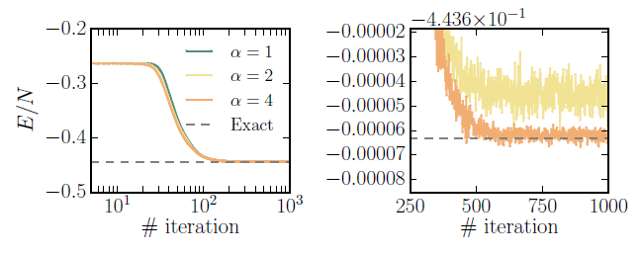
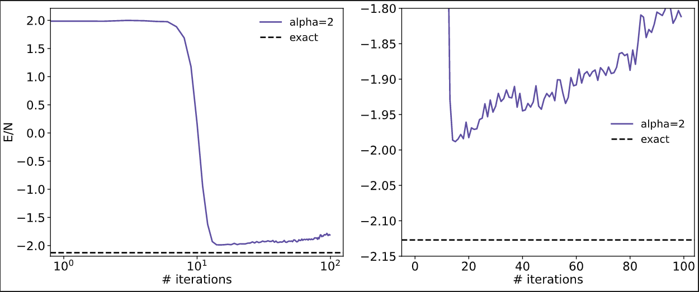
Results
Goal: recreate top figure
Result: bottom figure
Relative error ≈ 0.065+0j
Improvements: utilizing autodifferentiator (jax); setting E/N to starting value; using a variable learning rate; letting code run longer;

Slide 12
Discussion & Questions
Thank you for listening!

Slide 13
References
[1] Lindsey, M. (2019). The Quantum Many-Body Problem: Methods and Analysis. UC Berkeley. ProQuest ID: Lindsey_berkeley_0028E_19068. Merritt ID: ark:/13030/m53r60m7. Retrieved from https://escholarship.org/uc/item/8cc708cd
[2] Carleo, G. & Troyer, M. Solving the Quantum Many-Body Problem with Aritificial Neural Networks. arXiv:1606.02318 [cond-mat.dis-nn] (2016).
[3] Carleo, G. Personal Communications (2021).
[4] Deng, D., Xiaopeng, L., & Sarma, S. D. Machine learning topological states. arXiv:1609.09060v2 [cond-mat.dis-nn] (2017).

